Slide 1
The Consequences for State and Local Governments of the End of American Economic Hegemony
Michael J. Widmer
Boston Economic Club
January 30, 2013

Slide 2
Premise
A combination of economic, political, and social/cultural factors tied to the end of American economic hegemony will permanently constrain the ability of state and local governments to fund programs and services

Slide 3
Key Factors
Global economic competition
Loss of manufacturing jobs
Erosion of middle class
Aging of the population
Unaffordable public sector benefits
Fighting two wars while cutting taxes
Explosion of anti-government ideology
Unraveling of the American dream

Slide 4
America’s Ascendancy as the Global Economic Power

Slide 5
Ten-Fold Increase in U.S. Gross National Product
Source: U.S. Census, Statistical Abstract of the U.S., 1999

Slide 6
Growth in Manufacturing Drives Middle Class
Source: Moody’s Analytics

Slide 7
Median Family Incomes
Increase Seven-Fold
Source: U.S. Census, Statistical Abstract of the U.S., 1999 (Table 1427)

Slide 8
Percent of Owner-Occupied Homes Jumps 50 Percent
Source: U.S. Census, Statistical Abstract of the U.S., 1999

Slide 9
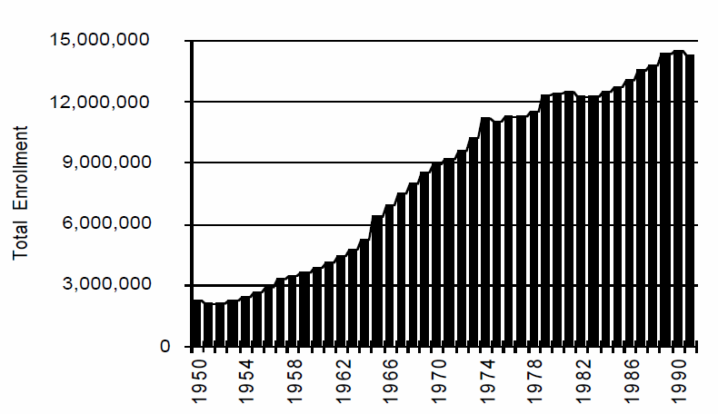
Higher Education Enrollment Soars
Source: Trends in United States Higher Education from Massification to Post Massification, Patricia J. Gumport et al, Stanford University, 1997

Slide 10
Growth in Power of
Public Sector Unions
Sources: Barry T. Hirsch and David A. Macpherson, "Union Membership and Coverage Database from the Current Population Survey: Note," Industrial and Labor Relations Review, Vol. 56, No. 2, January 2003, pp. 349-54. (in pdf); data not available for 1982

Slide 11
Political Underpinnings
Broad bipartisan support for a national social agenda to build a safety net for those in need

Slide 12
The Unraveling of the American Dream

Slide 13
GNP Has Continued to Grow But Underlying Economic and Political Forces Have Changed Dramatically
Source: St. Louis Federal Reserve

Slide 14
U.S. Dominance of Global Economy Erodes
Source: WorldBank

Slide 15
Dramatic Drop in
Manufacturing Jobs
Source: Moody’s Analytics

Slide 16
Long-Term Decline in Private Sector Unions
Sources: Barry T. Hirsch and David A. Macpherson, "Union Membership and Coverage Database from the Current Population Survey: Note," Industrial and Labor Relations Review, Vol. 56, No. 2, January 2003, pp. 349-54. (in pdf); U.S. Bureau of Labor Statistics

Slide 17
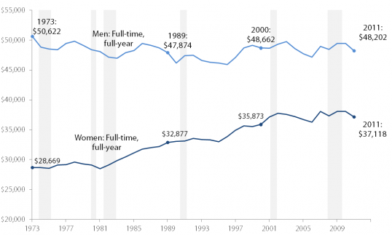
Men’s Real Income Has Fallen
Over Past 40 Years
Source: Already more than a lost decade, Heidi Shierholz and Elise Gould, Economic Policy Institute, September 12, 2012

Slide 18
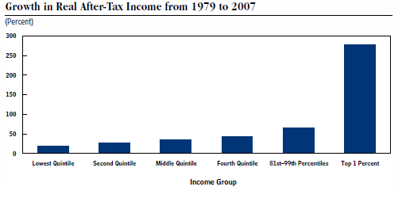
The Middle Class is Being Left Behind
Top 1% of Households | 275%
Middle Fifth of Households | 35%
Poorest Fifth of Households | 18%
Real GDP | 125%
Source: Congressional Budget Office, Trends in the Distribution of Household Income Between 1979 and 2007, October 2011; Moody’s Analytics

Slide 19
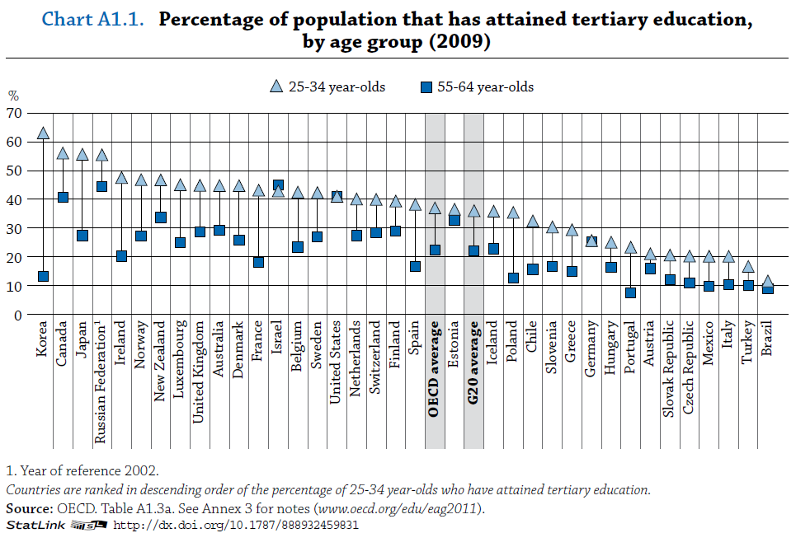
U.S. Trailing Other Nations in Educating the Next Generation
Source: OECD

Slide 20
Joseph Stiglitz: 'The American Dream Has Become a Myth'
SPIEGEL: The US has always thought of itself as a land of opportunity where people can go from rags to riches. What has become of the American dream?
Stiglitz: This belief is still powerful, but the American dream has become a myth. The life chances of a young US citizen are more dependent on the income and education of his parents than in any other advanced industrial country for which there is data. The belief in the American dream is reinforced by anecdotes, by dramatic examples of individuals who have made it from the bottom to the top -- but what matters most are an individual's life chances. The belief in the American dream is not supported by the data.
Source: Der Spiegel interview with Joseph Stiglitz, October 2, 2012

Slide 21
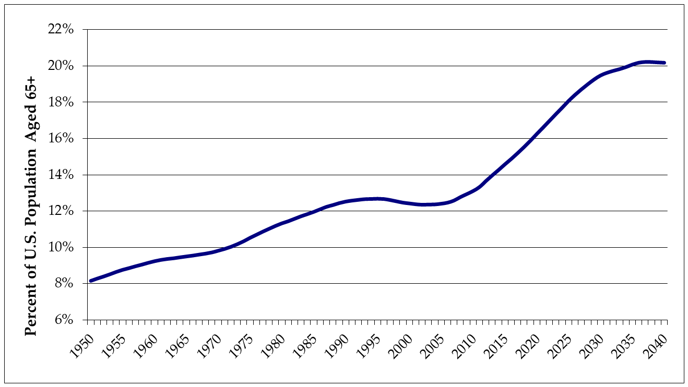
A Rapidly Aging Population Adds to the Fiscal Burden
Source: Moody’s Analytics

Slide 22
Fewer Workers Covering More Social Security Beneficiaries
Source: Social Security Administration

Slide 23
Staggering Costs of
Retirement Benefits
Nationally, unfunded liabilities for retirement benefits total well over $1 trillion. In Massachusetts, state and municipalities have more than $80 billion in unfunded liabilities for retirement benefits already earned.
Pensions | Unfunded Liability (billions)
State | $7.3
Teachers | $14.3
Municipal | $13.1
Retiree Health Care
State | $16.7
Municipal | $30.0
Total | $81.4

Slide 24
Public Sector Employees Cost Roughly 30 Percent More Than Private
Source: U.S. Bureau of Labor Statistics, Employer Cost for Employee Compensation, December 11, 2012

Slide 25
Health Care Costs Growing
Twice the Rate of Inflation
Source: St. Louis Federal Reserve

Slide 26
Public Sector Unions on the Defensive
Sources: Barry T. Hirsch and David A. Macpherson, "Union Membership and Coverage Database from the Current Population Survey: Note," Industrial and Labor Relations Review, Vol. 56, No. 2, January 2003, pp. 349-54. (in pdf); U.S. Bureau of Labor Statistics

Slide 27
Bush Tax Cuts and Recession Drive Down Federal Revenues
Bush Tax Cuts
Recession
Source: www.whitehouse.gov/omb/budget/Historicals

Slide 28
Federal Revenues Fall Below Spending Growth
Bush Tax Cuts
Source: www.whitehouse.gov/omb/budget/Historicals

Slide 29
The Plague of Federal Deficits
Source: www.whitehouse.gov/omb/budget/Historicals

Slide 30
New Political Realities
Fracturing of consensus on the role of government
Debate moves to the right
Anti-tax ideology becomes centerpiece of Republican Party
Large federal spending cuts and entitlement reforms will dominate the Washington debate over the next decade

Slide 31
The Squeeze on State and
Local Governments
Federal deficit reduction
Aging of the population
Paying for generous retirement benefits
Public much less receptive to tax increases
Broad distrust of government’s ability to address social problems

